Slide 1
The Bifurcation of Global High Yield Corporate Fundamentals - Brian Fagan , MacKay Shields

Slide 2
US High Yield
USHY Leverage Continues to Climb driven primarily by the energy & materials sectors. Is leverage rising in other areas of the market? Or is it just concentrated within the energy & materials sectors?
So leverage is rising, what does this mean for investors? As long as issuers can service their debt and/or refinance investors should continue to receive interest payments. Right? I would argue that depends on a number of variables.

Slide 3
1) Interest Coverage
Interest Coverage, or how many times over an issuer can pay its interest payments is defined as the last twelve months (LTM) of EBITDA per unit of LTM Interest Expense.
As shown above, interest coverage including commodity sectors has fallen dramatically and is now slightly below the low’s of 2009. Excluding commodity sectors, interest coverage is slightly below it’s all-time high at 3.6x. Excluding commodity sectors, us high yield issuers show no sign of deterioration in their ability to pay interest payments. However, could that change? If so, how?

Slide 4
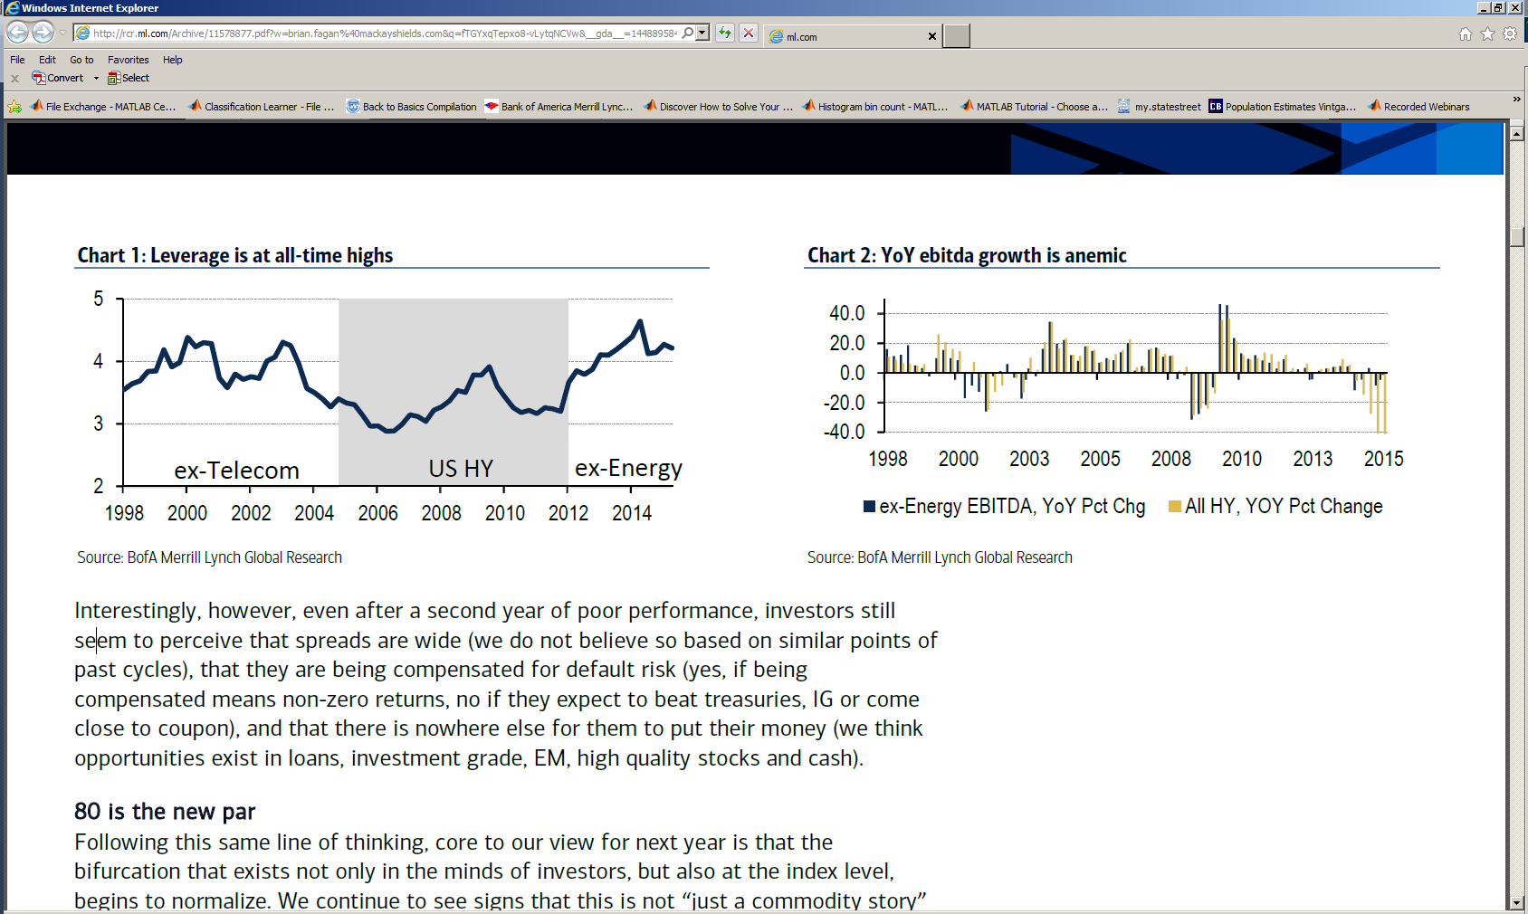
2) A decline in Operating Income and an increase in debt
Growth in Face Value of Debt (8/31/1986 – 11/30/2015)
As shown above, operating income, including and excluding energy, continues to be weak. Even excluding energy, the year-over-year, issuer matched, EBITDA % change has been negative for the past two quarters. Assuming this trend continues and the stock of debt and interest payments remains constant, interest coverage will fall and leverage will rise. So how much of the market, on a percentage basis, will come due next year? After all, a default can only occur for a bond that is coming due.

Slide 5
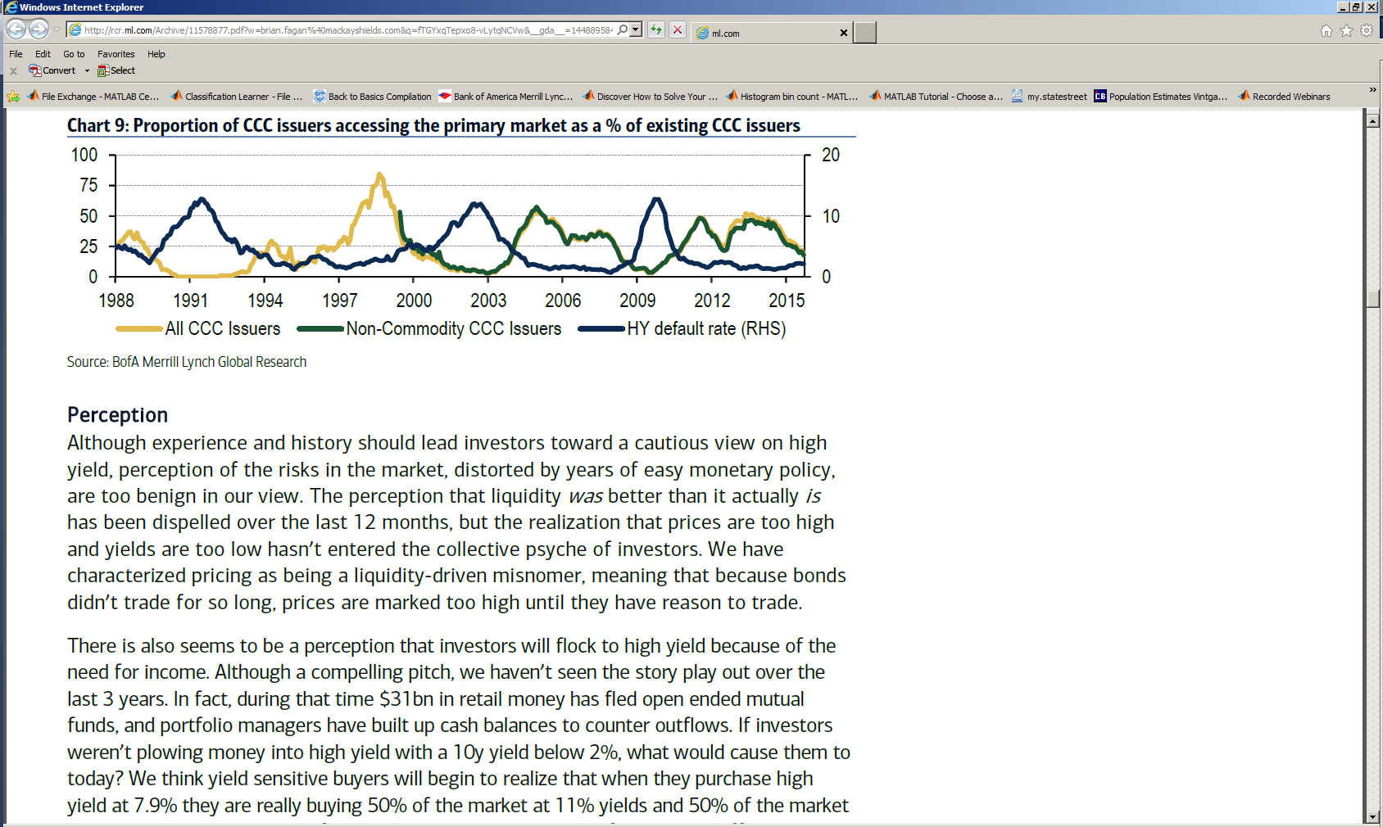
3) The inability for “Risky Issuers” to access the market to Refi
The numbers of CCC issuers accessing the primary market as a percentage of CCC issuers has been declining since mid 2014. This trend is not constrained to issuers in Commodity sectors, non-commodity issuers have exhibited an almost identical pattern. If the riskier part of the market is not accessing the market, how much debt is due within the nest few years as a percentage of debt outstanding?

Slide 6
4) Historical Cumulative Maturity Distribution
The black line is the current cumulative maturity distribution as of 11/30/2015. Debt due within 3 years represents 12.3% of the market. There are only two other time periods over the past 20 years where a larger percent of total U.S. high yield debt outstanding was due within 3 years. Those periods were at the end of 2008 and 2009. Subsequently, the USHY default rate reached its all-time high of 14.7% on 11/30/2009. So what is the current composition of the 1-3 year bucket? After all, if majority of the constituents are higher quality names then they should be able to refinance or pay off the principal balance.

Slide 7
4a) Historical Cumulative Maturity Distribution Continued…
11/30/2015 1-3 Year Maturity Bucket
CCC Issues with Maturity less than 3 Years as a % of Total Debt Outstanding
As shown in the table to the left, of the 12.3% of USHY bonds due within 3 years, 20.5% are rated CCC & below. This amount equals 2.5% of all USHY outstanding debt. On the surface, 2.5% sounds low but from a historical perspective it is not. In reality, it is the highest percent this cycle and trending higher. During the past two cycles, CCC issues with a maturity less than 3 years as a % of total debt outstanding reached 2.5% on 11/30/2001 and 8/31/2008.

Slide 8
Euro High Yield
So U.S. High Yield fundamentals are deteriorating, is the same true for euro high yield issuers?
Fundamental deterioration does not seem to be present for euro high yield issuers. Interestingly enough, leverage declined last quarter from 2.9x to 2.6x. However since the beginning of the current cycle, change in leverage by euro area region has varied quite significantly as shown above. While leverage declined for non euro area and core issuers after the financial crisis, leverage for issuers in peripheral countries climbed until mid 2012. Also, leverage for non euro area issuers rose sharply throughout 2014 and is now in steady decline. What caused this dispersion in leverage amongst euro area regions in the beginning of the cycle and recently?

